Slide 1
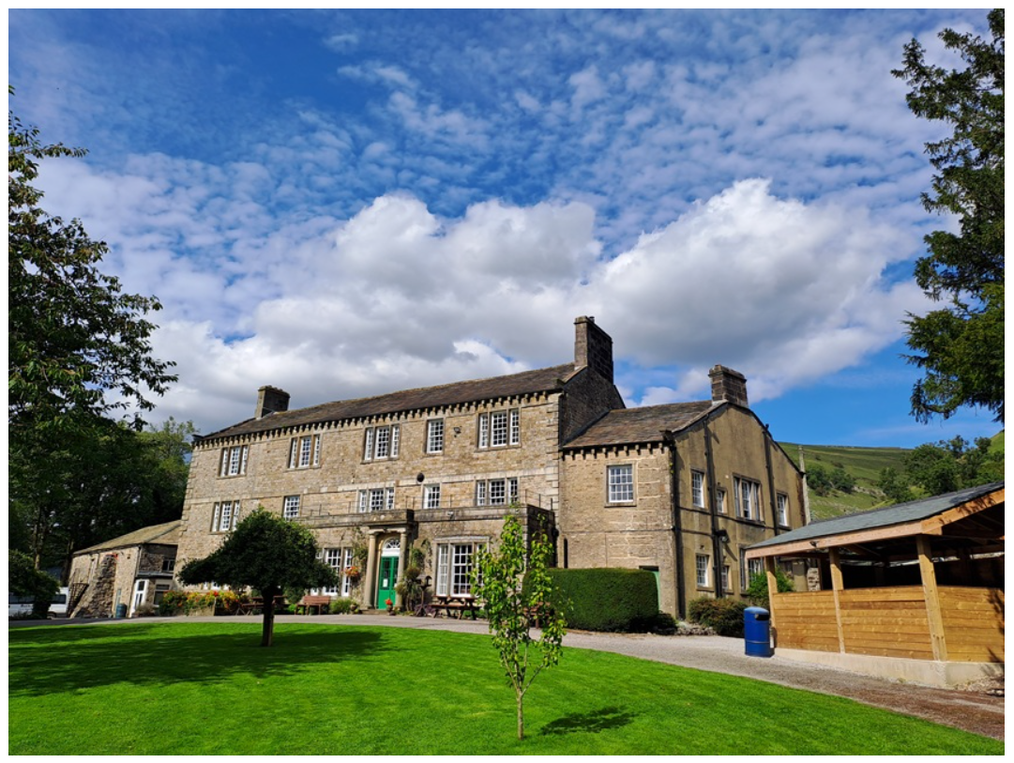
Notes:
Aaron

Slide 2
Year 6 Residential
Buckden House Outdoor Education Centre
Wednesday 20th January 2027 to
Friday 22nd January 2027
Notes:
Aaron

Slide 3
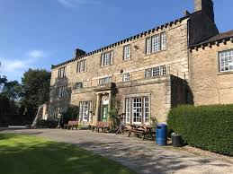
Why do we go to Buckden House?
Provide children with the opportunity to ‘push themselves’ and take them ‘out of their comfort zone’; taking part in a wide range of exciting outdoor adventurous activities.
Links to the children’s learning, focusing on developing children’s geography skills such as map reading, and using a compass; as well as PSHE skills such as problem solving and co-operation.
Notes:
Aaron

Slide 4
Why do we go to Buckden House?
To have fun!
Making memories!
Notes:
Aaron

Slide 5
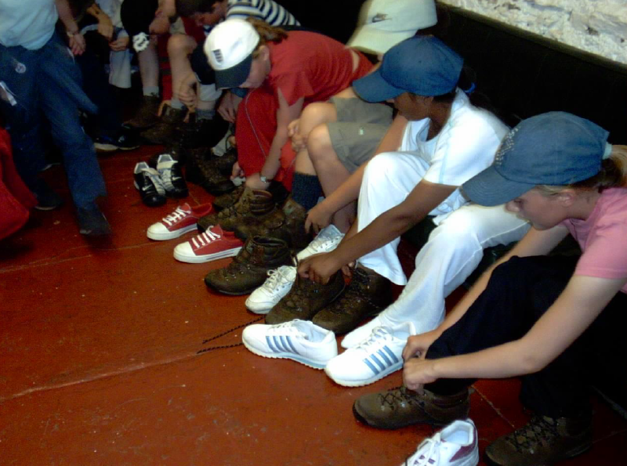
Kitting up
Buckden House will provide:
- walking boots / wellies
- waterproof trousers
- waterproof jackets / cagoules
- rucksacks
Notes:
Catherine

Slide 6
Kit List
Outdoor
5 pairs of walking socks (preferably thick ones, to be worn with boots and Wellingtons. Wool/nylon loop stitch are ideal)
5 pairs of ordinary socks
5 items of underwear
5 pairs of outdoor trousers e.g. tracksuit bottoms or leggings (no jeans)
1 woolly / fleecy hat
1 pair of gloves
3 fleeces / sweatshirts
5 long / short sleeve t-shirts
1 light jacket / fleece
1 outdoor coat
1 pair of outdoor shoes e.g. trainers
Large plastic bag for dirty / wet clothes
Indoor
1 pair of slippers (sensible)
2 changes of casual clothes to be worn on an evening (jeans can be worn)
Nightwear (warm and suitable to be worn in public)
1 hand towel
1 bath towel
Reading book / puzzle book / magazine / soft toy (optional)
Toiletries
Comb / brush / hair bobbles
Shower gel
Shampoo
Toothbrush / toothpaste
Roll on deodorant, no aerosols
Notes:
Catherine

Slide 7
Packing
Everything needs to be named (including underwear and socks).
Please make sure that your child is present when you pack the bag (include a list of the contents).
Please do not send your child with a mobile phone, tablet or other similar device. If you have any concerns, please speak to us. We will provide regular updates throughout the trip but please note, that this will typically be on an evening due to the full list of activities undertaken.
Notes:
Catherine

Slide 8
Medical
First Aider
Medicines (prescription & non-prescription)
Travel sickness
Is there anything else we need to know about your child?
Illness prior to Buckden House
Do you need to update us?
Notes:
Aaron

Slide 9
On the day
Trainers, jogging bottoms, t-shirt, fleece/sweatshirt (all included in above kit numbers).
Lunch (packed in a carrier bag with name on it) / school dinners.
Leave Wellington in the morning and arrive ready:
  Outdoor classroom: discuss Health and Safety, expectations etc.
  Kit
  First activity
Notes:
Aaron

Slide 10
Day time activities
The children will be in groups no larger than 10, plus a Buckden House instructor and a member of school staff
Day time activities:
- Gorge scrambling
- Caving
- Deer Park walk
- Tree climbing / high ropes
Notes:
Catherine

Slide 11
Risk Assessment
Buckden House staff have considerable experience and expertise in risk analysis. The centre has an excellent safety record.
All of Buckden House’s risk assessments are shared with visiting group leaders to assist their planning.
Buckden House believe that undue risk is not necessary.
Notes:
Catherine

Slide 12
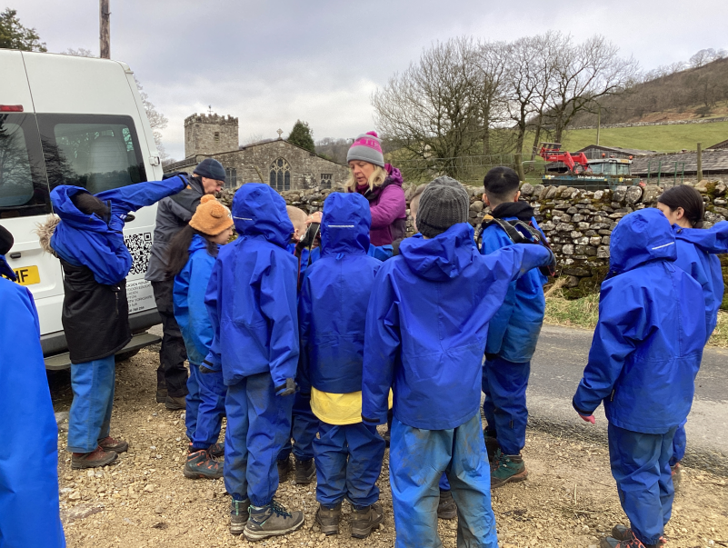
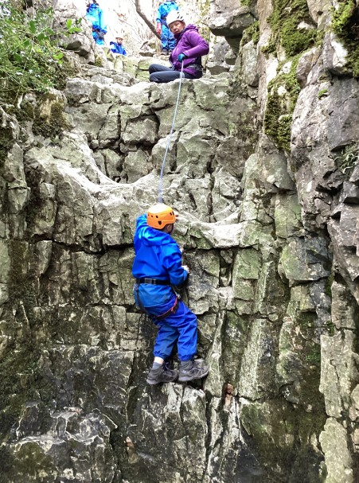
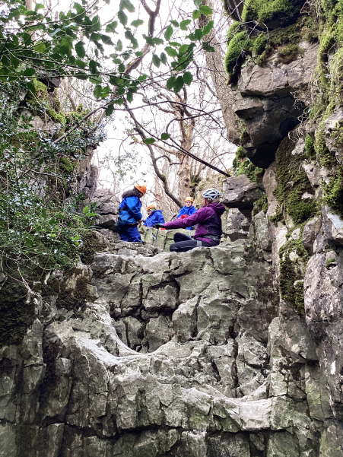
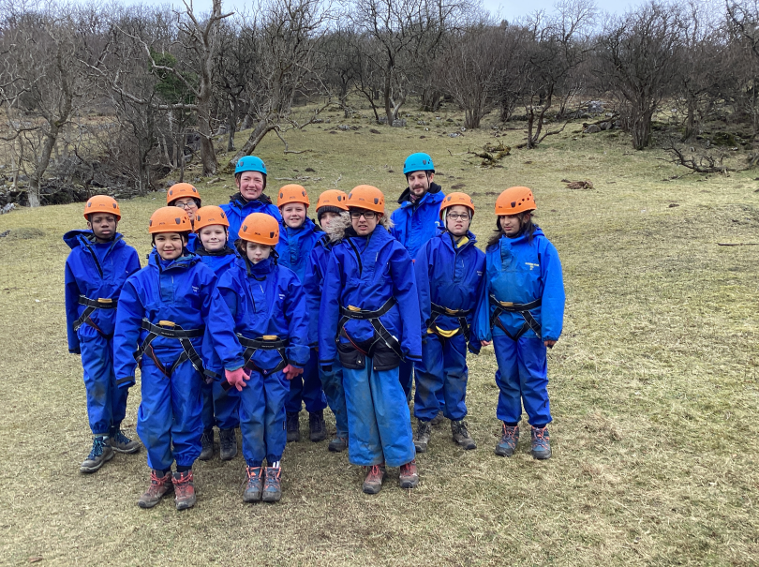
Gorge
Scrambling
Notes:
Aaron

Slide 13
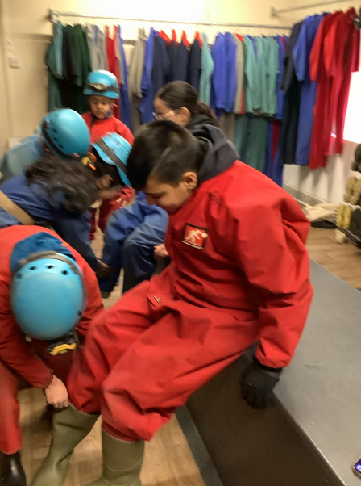
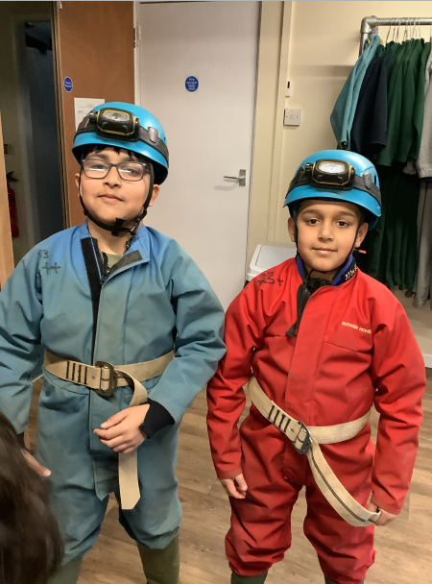
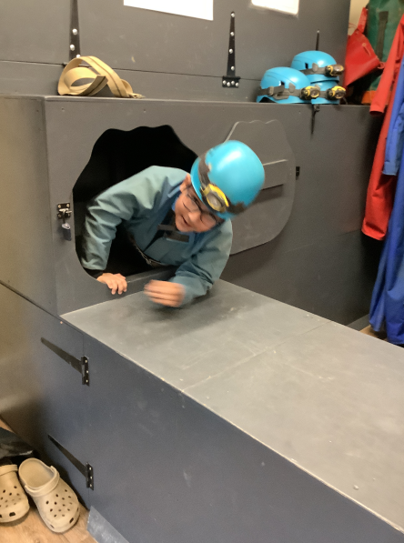
Caving
Notes:
Catherine

Slide 14
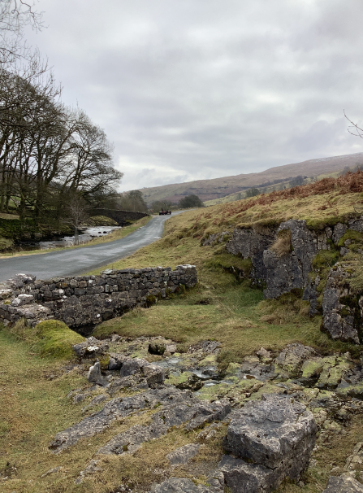
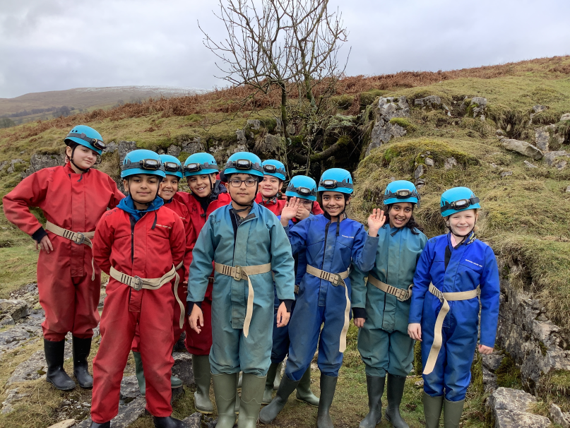
Caving
Notes:
Catherine

Slide 15
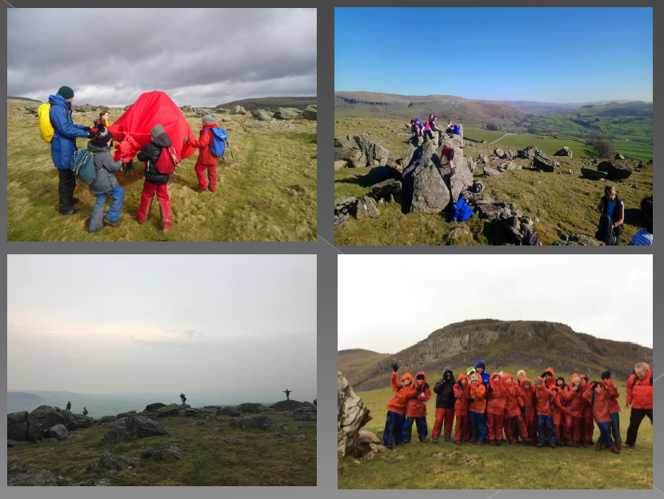
Deer Park Walk
Notes:
Aaron

Slide 16
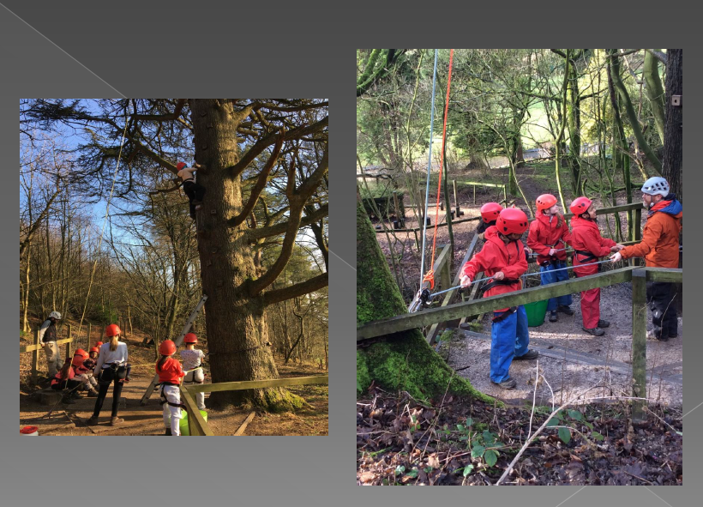
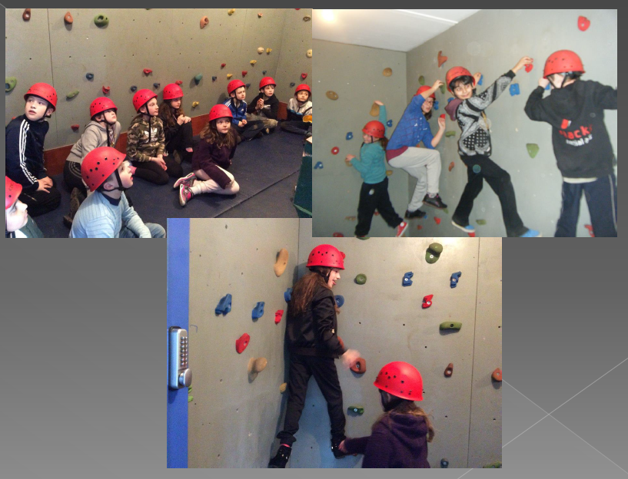
High ropes/ tree climbing
Notes:
Catherine

Slide 17
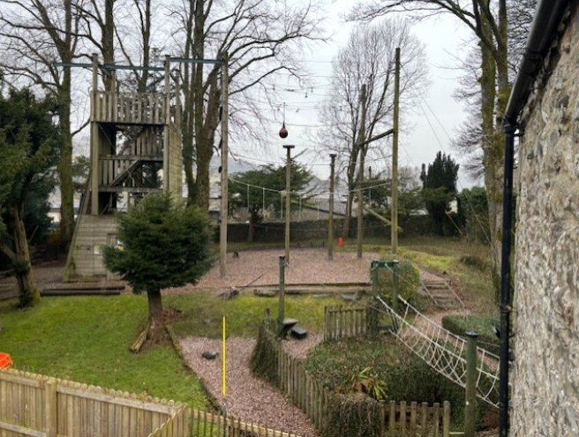
High ropes/ tree climbing
Notes:
Catherine

Slide 18
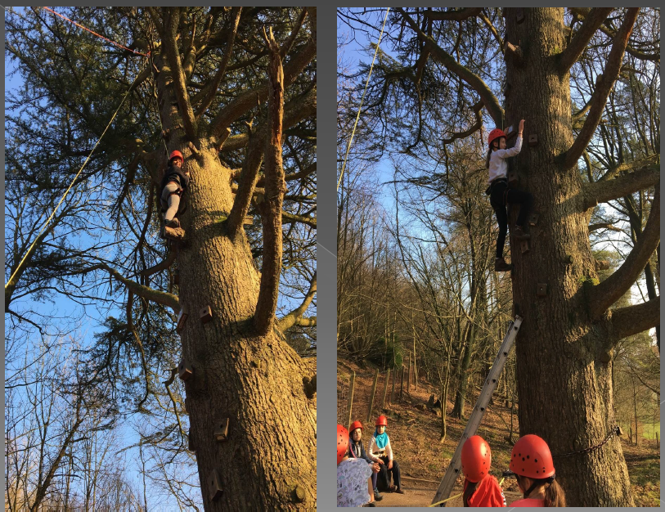
High ropes/ tree climbing
Notes:
Catherine

Slide 19
Night time activities
The children will take part in a variety of night time activities, including:
- indoor / outdoor games
- night walks
- campfire
- quizzes / puzzles
- arts and crafts
- story telling
- adventure playground
A small shop selling souvenirs is available. Maximum £5.
Notes:
Aaron

Slide 20
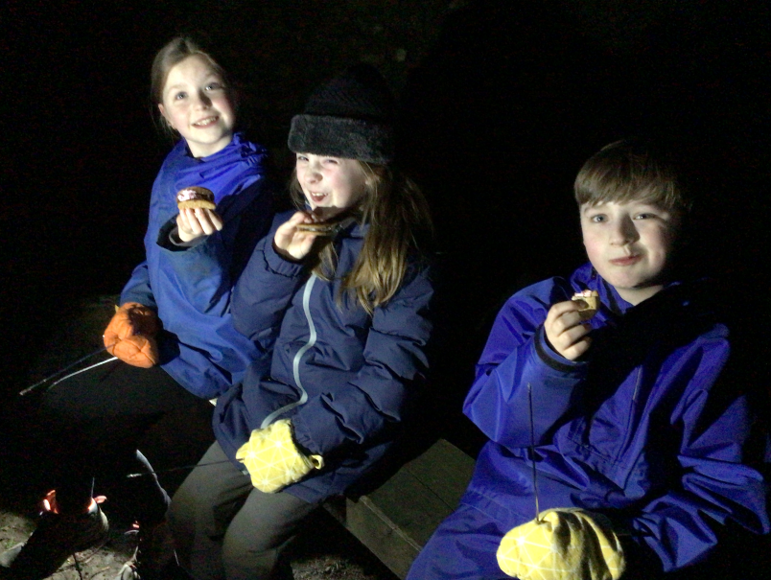
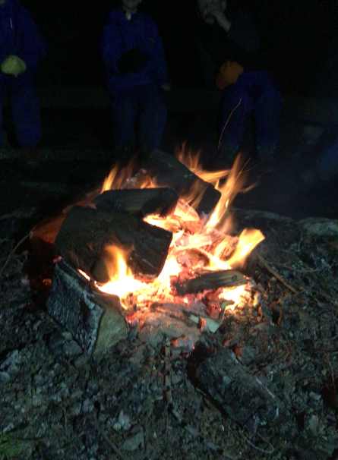
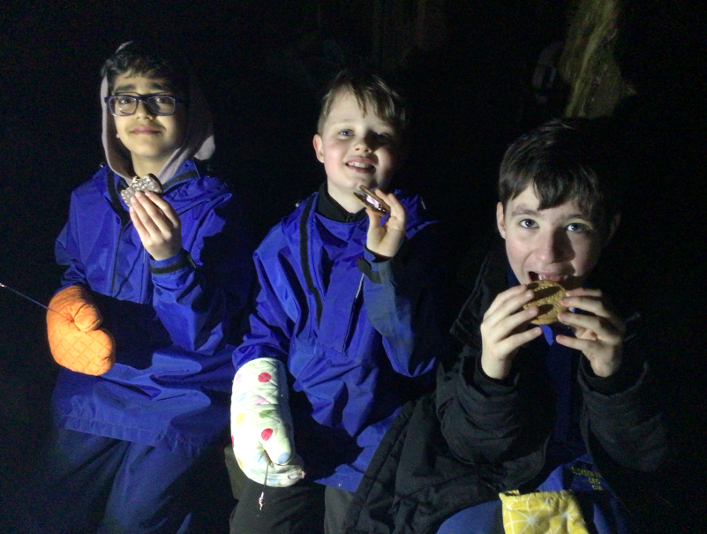
Notes:
Aaron

Slide 21
Accommodation
The children are accommodated in small, single gender dormitories in bunk beds (typically 4 or 6 to a room).
Accompanying adults are provided with bedrooms either adjoining or close by to our allocated dormitories.
The children will need to make their own beds.
Notes:
Catherine

Slide 22
Food
Breakfast: cereal, toast, cooked breakfast.
Lunch: Other than on the first day, when you will need to provide a packed lunch, your child will be provided with a lunch. This will consist of sandwiches, a packet of crisps, a snack bar, a piece of fruit and a drink.
Evening meal: wide range of hot cooked dishes, including halal options.
Supper.
Notes:
Catherine

Slide 23
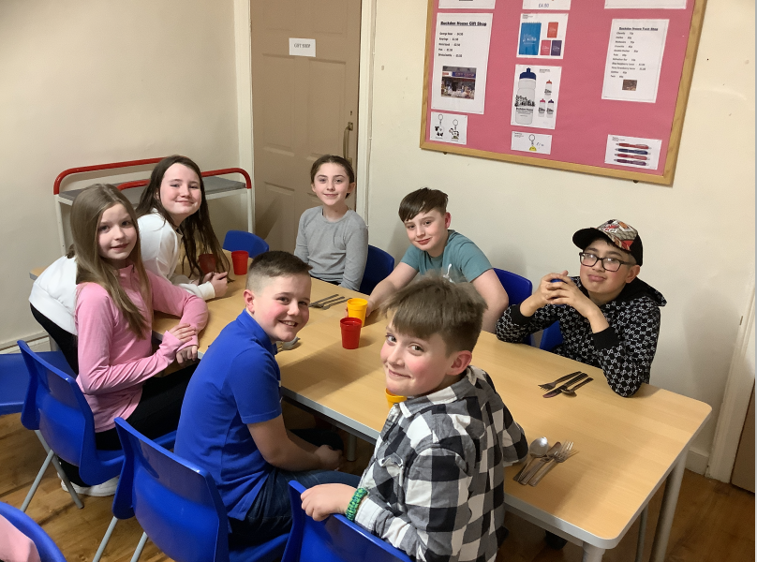
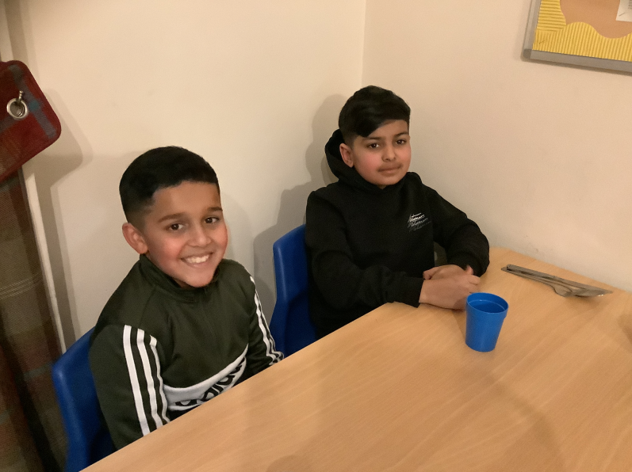
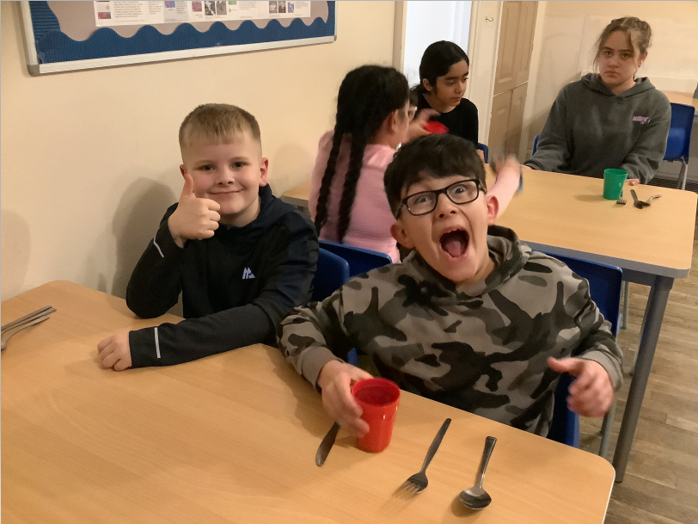
Notes:
Catherine

Slide 24
What’s next?
£295.00
£100.00 non-refundable deposit, via Arbor, to secure a place.
Deadline: Wednesday 30th September.
Remaining balance can be paid in instalments via Arbor. Deadline: Thursday 31st December.
Please contact us if you have any concerns about paying for the residential.
Notes:
Aaron

Slide 25
Any questions?
Notes:
Aaron / Catherine

